Slide 1
REPORT OF WORLD POPULATION ANALYSIS AND FORECASTING
KAYODE OLUBUNMI
AUGUST 2024

Slide 2
1
ABSTRACT
There has been a rise in the population worldwide with Nigeria, a developing country not left behind.
The dataset used for this analysis was downloaded from Kaggle and analyzed in python.
The result shows a rise in the population growth in Nigeria and worldwide and the forecast shows that this trend will continue in the next 30 years.
Policy makers should therefore ensure policies especially in relation to birth control are made.

Slide 3
2
OVERVIEW
Introduction
Result
References
Objectives
Discussion
Methodology
Recommendation

Slide 4
3
INTRODUCTION
The population worldwide continues to be on the rise despite factors militating against this rise. These include reduced fertility, increased mortality, and climate change.
Nigeria, a developing country has also been experiencing this rise despite its economic situation.

Slide 5
4
OBJECTIVES
To determine the trend of population growth worldwide in last 60 years.
To determine the trend of population growth in Nigeria in last 60 years.
To forecast world population in next 30 years.
To forecast Nigeria population in next 30 years

Slide 6
5
METHODOLOGY
Dataset was downloaded from Kaggle.
Data analysis was carried out with python.
Essential libraries and dataset were imported into google colab.
Data cleaning and exploration were done.
Data was subsequently analyzed.

Slide 7
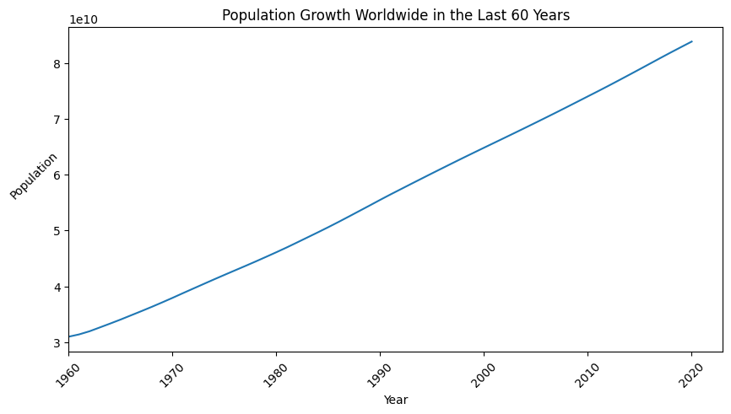
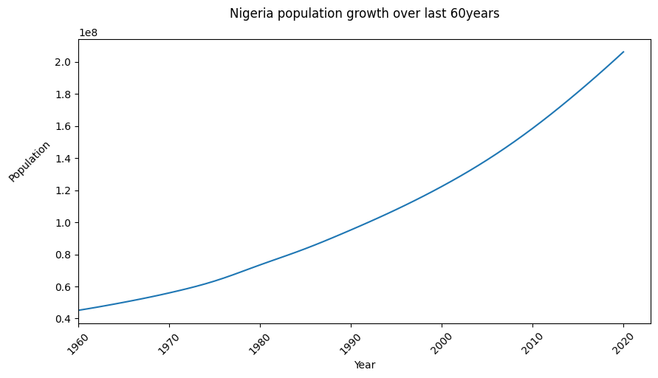
6
﻿RESULT
Trend of population growth worldwide in last 60 years
Trend of population growth in Nigeria in last 60 years
The above charts shows similarity between the trend of population growth worldwide and in Nigeria.
It can be observed that there has been a sharp rise in population over the past 60 years worldwide whereas in Nigeria, it can be observed as a slopy rise.

Slide 8
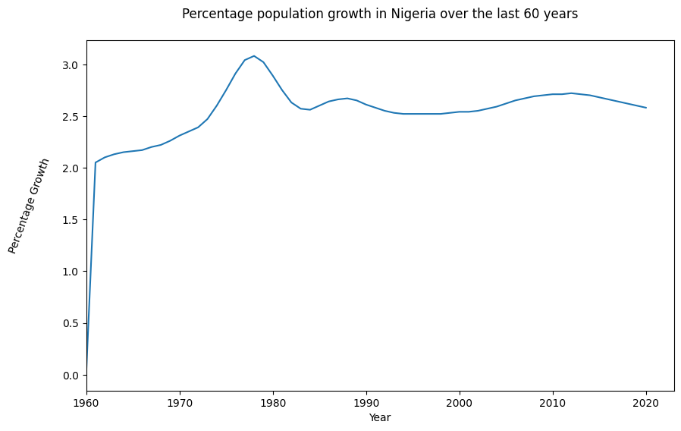
7
﻿RESULT
The percentage of population growth increased between the years 1960 and 1980 and experienced a fall between the years 1980 and 1985.
This rate of growth has been maintained since 1985

Slide 9
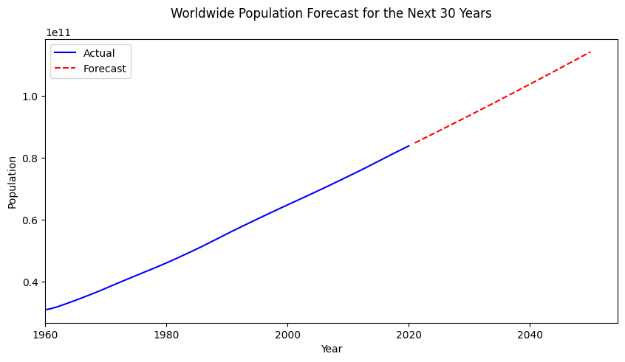
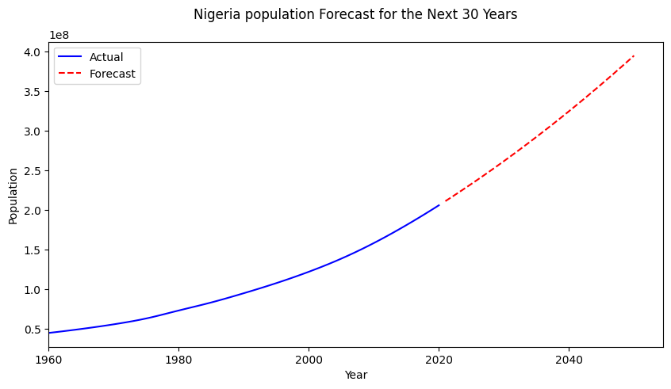
7
﻿RESULT
Forecast of population worldwide in next 30 years
Forecast of population in Nigeria in next 30 years
The above charts shows that Nigeria as a country will have a resemblance with the trend of population growth worldwide and likely experience a continuous increase in population over the next 30 years .

Slide 10
8
DISCUSSION
The world has been experiencing a continuous growth in its population although at a reduced percentage in recent times. This reduced percentage has been attributed to reduced fertility and increased mortality (Gu et.al, 2021)
Additionally, Nigeria has recorded a high population growth rate which would likely increase more in the future (Ogunleye et.al, 2018)

Slide 11
9
RECOMMENDATION
Birth control policies should be enacted as this will reduce population, reduce overcrowding which precedes several childhood diseases, prevent malnutrition and prevent economic meltdown.
Early marriages can be reduced by educating the public on its significance.

Slide 12
9
REFERENCES
Gu D., Andrreev K. & Dupre M.E. (2021). Major Trends in Population Growth Around the World. ChinaWkly, 3(28): 604-613. doi: 10.46234
Ogunleye O,O., Owolabi O.O & Mubarak, M. (2018). Population Growth and Economic Growth in Nigeria: An Appraisal. International Journal of Management, Accounting and Economics, 5(5).

Slide 13
THANK YOU

